Slide 1
FOREVER 21+
Where are the NYC Tobacco and liquor retailers ?
Team Member:
Forever 21’s members:
Cheng Hou, Le Xu, Xiaomeng Dong, Xin Tang, Chenxi Cui, Henri Lin

Slide 2
Analysis on NYC Tobacco & Liquor retailer Stores
Data Source
Methodology
Analysis
Conclusion
Introduction

Slide 3
Introduction
Tobacco stores and Liquor stores are important parts of NYC small business community.
Our Initial Guess:
Those stores normally appear themselves in those busy, populated and commercial areas.
Liquor Stores and Tobacco stores have the similar distribution patterns.
The study of the distribution of tobacco and liquor stores can help us understand the social and economic aspects of New York City.

Slide 4
Analysis on NYC Tobacco & Liquor retailer Stores
Data Source
Methodology
Analysis
Conclusion
Introduction

Slide 5
Data Source
Tabaco Retailer location Data:
NEW YORK STATE OPEN DATA (Up-to-date)
Liquor Retailer Location Data
Including Beer, Wine and Hard Liquor
NEW YORK STATE OPEN DATA (Up-to-date)
Median Income Data on the Census Tract
With different races
Census Bureau Data (2010)
Limitation :
1. Tobacco stores could be convenient stores as well.
2. No data on tobacco and liquor sales

Slide 6
Analysis on NYC Tobacco & Liquor retailer Stores
Data Source
Methodology
Analysis
Conclusion
Introduction

Slide 7
Methodology
Study the available datasets on both Zip code level and census tract level
Data Wrangling and Processing:
Python, Pandas
Data Visualization:
Matplotlib, Seaborn, Tableau, ArcGIS

Slide 8
Analysis on NYC Tobacco & Liquor retailer Stores
Data Source
Methodology
Analysis
Conclusion
Introduction

Slide 9
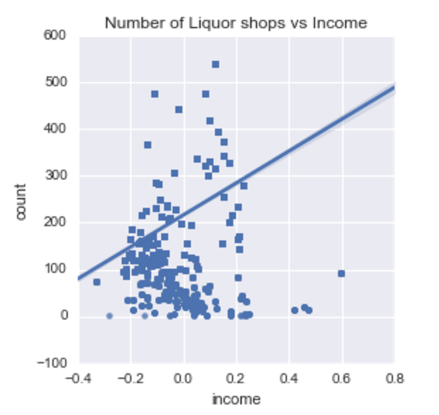
Exploratory: Linear Regression on Income and Liquor shops counts
* Normalized Income data

Slide 10
Liquor Store counts on Zipcode Level

Slide 11
Tobacco Store counts on Zipcode Level
11385, Ridgewood, Glendale
11207,
East New York

Slide 12
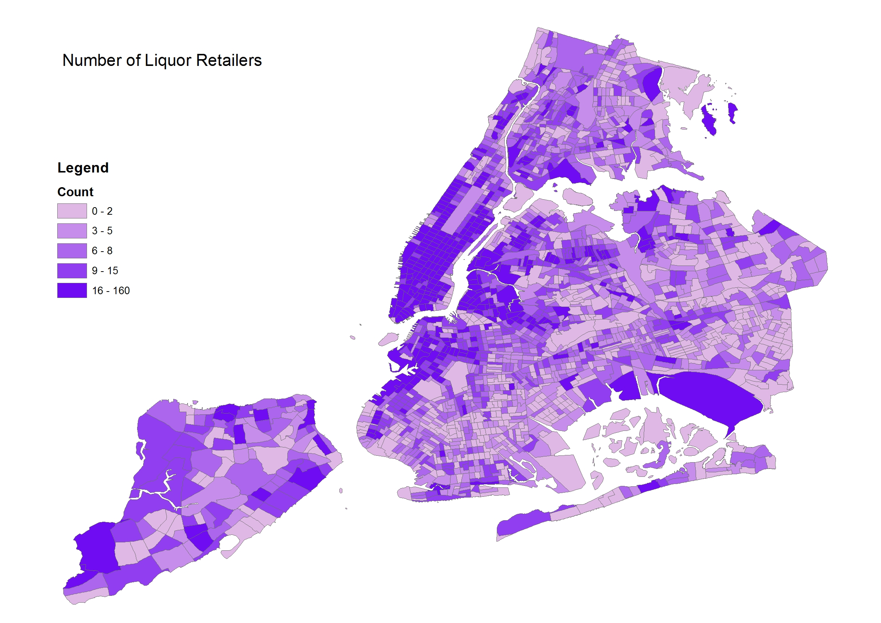
Liquor Store counts on Census Tract Level

Slide 13
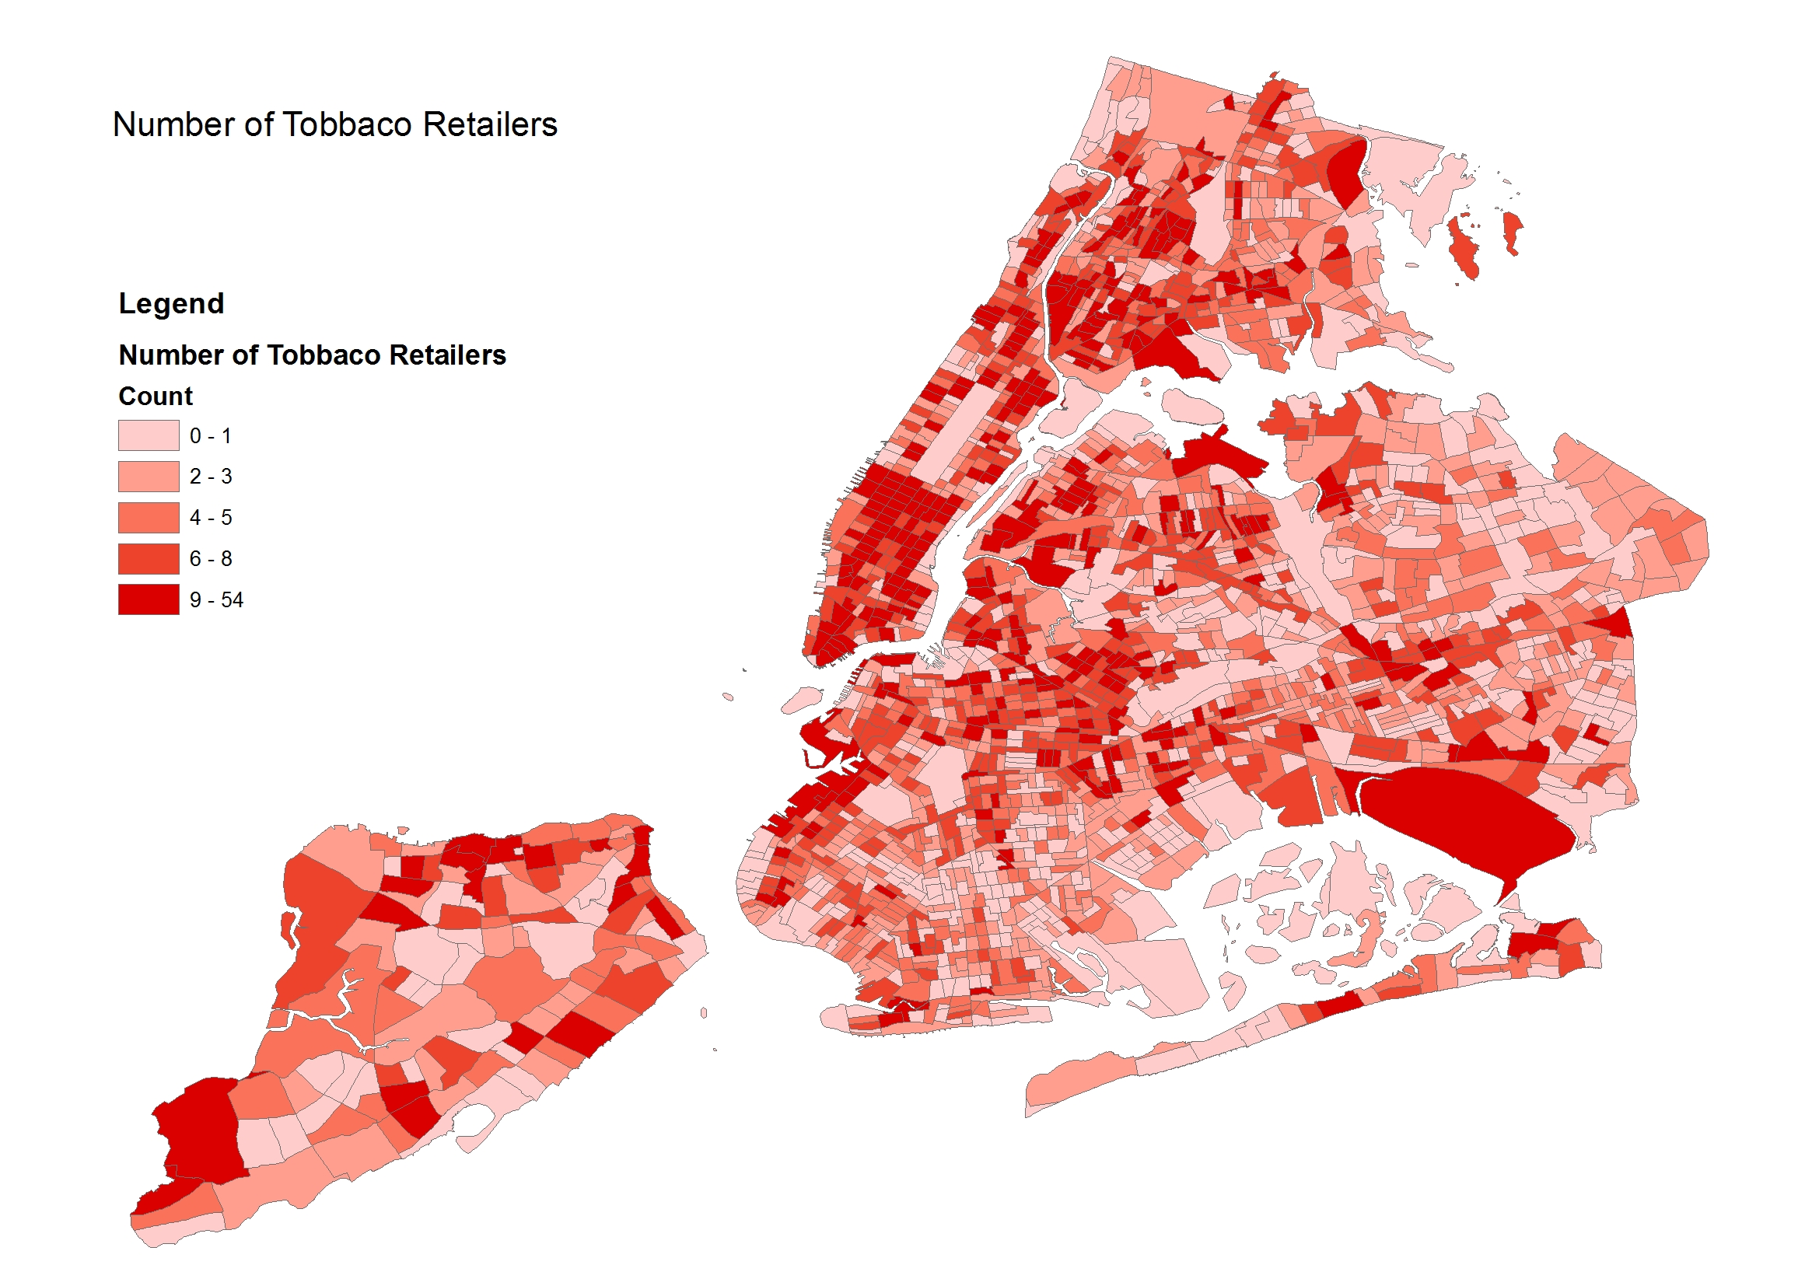
Tobacco Store counts on Census Tract Level

Slide 14
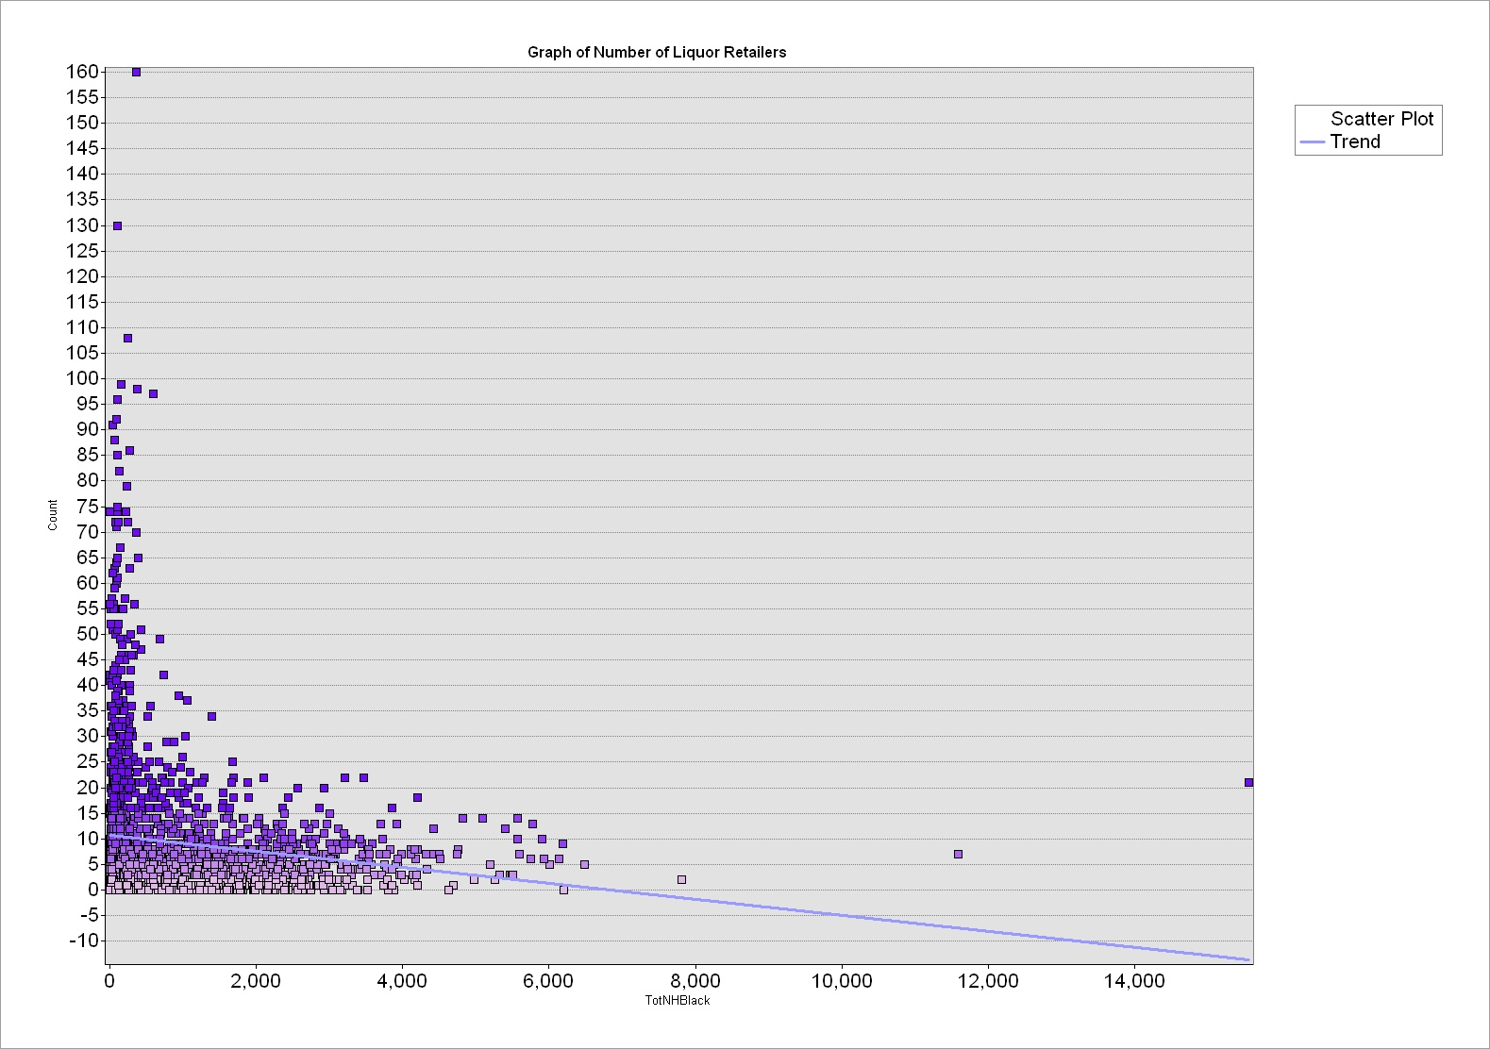
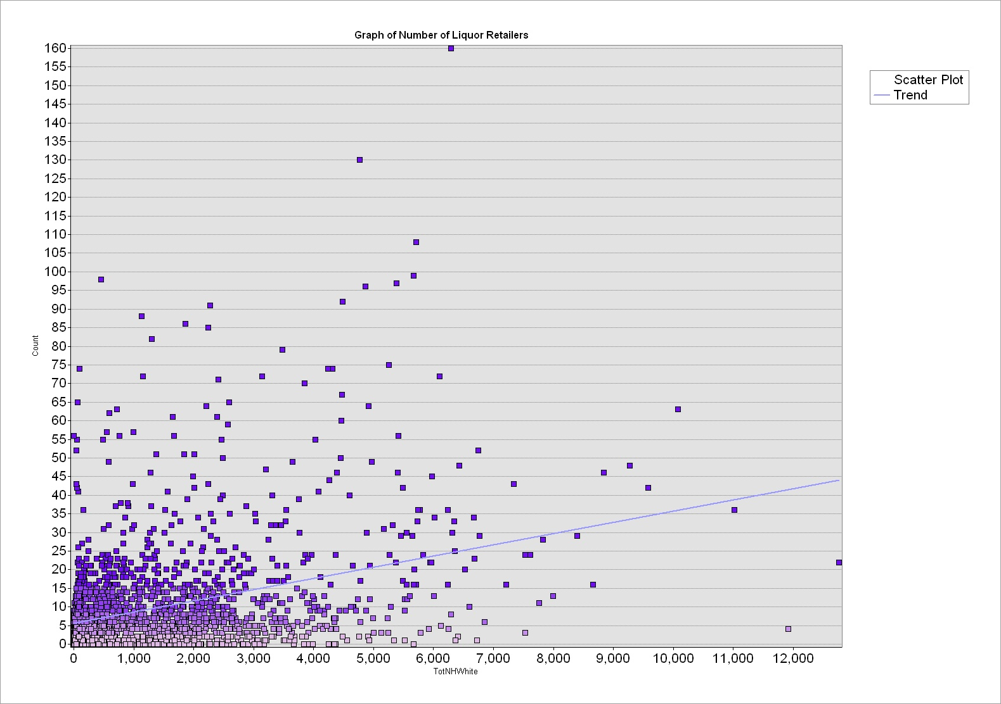
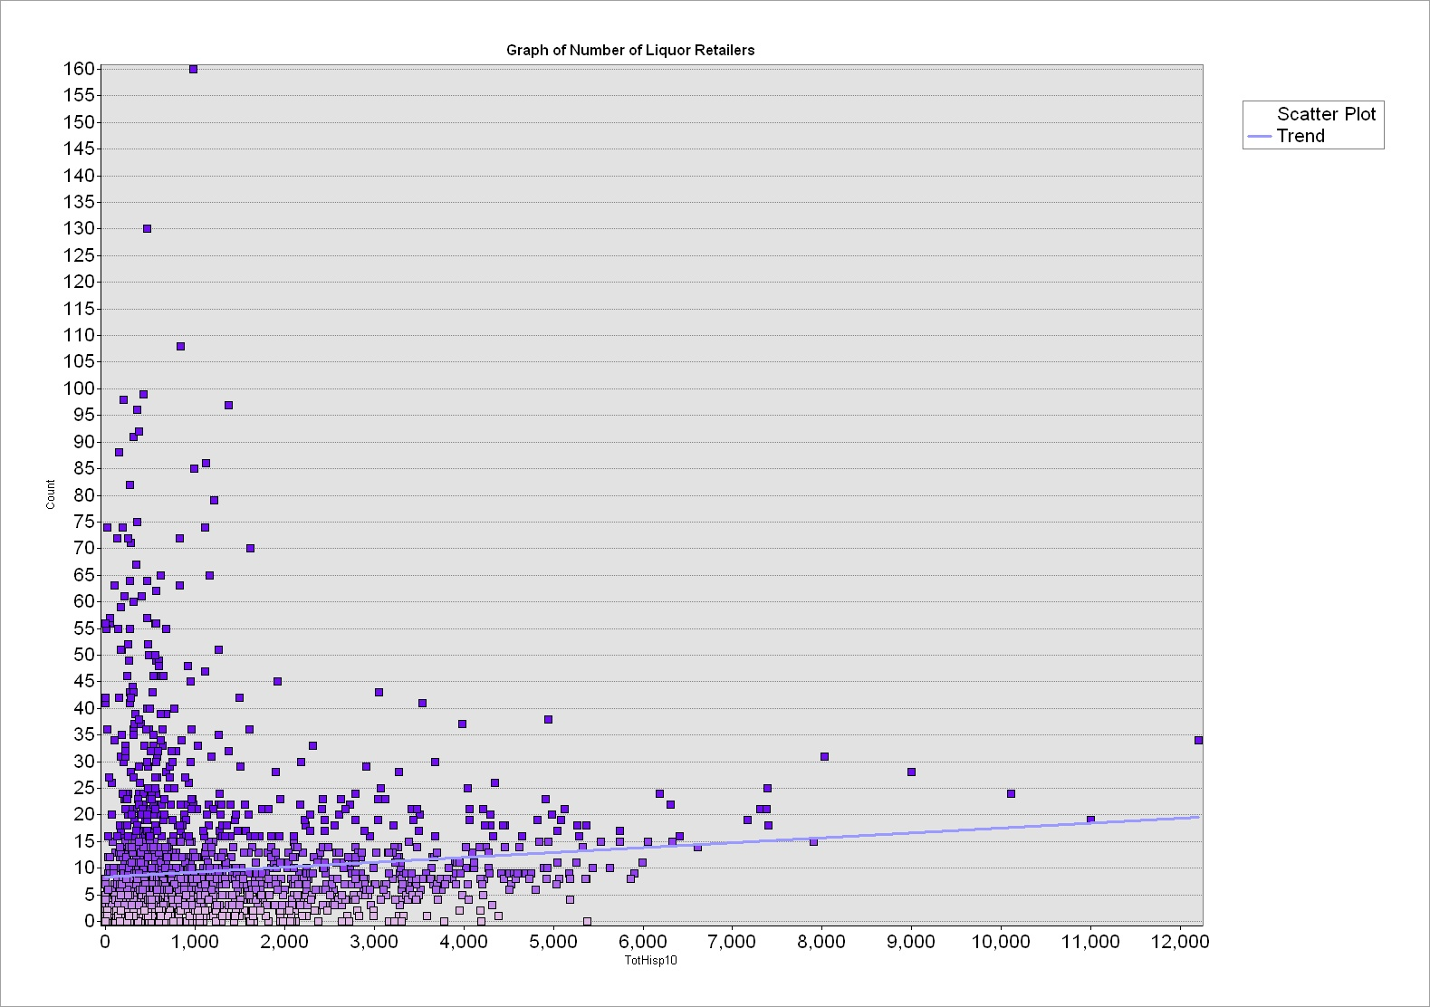
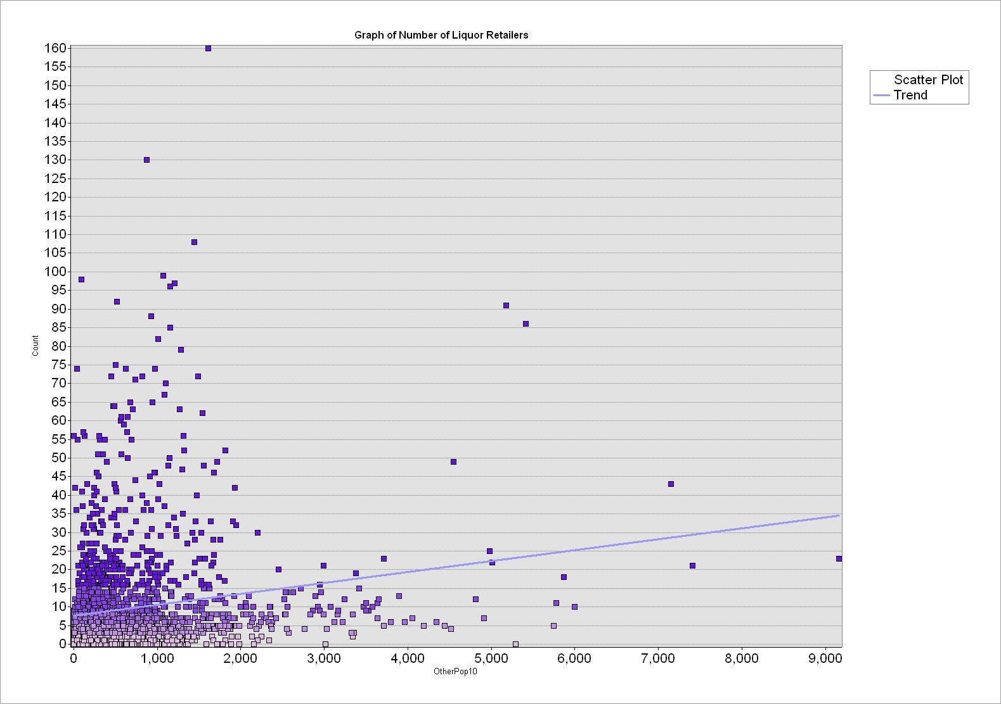
NH African American
NH White
Number of Liquor Retailers VS Different Ethnics
Others
Hispanic

Slide 15
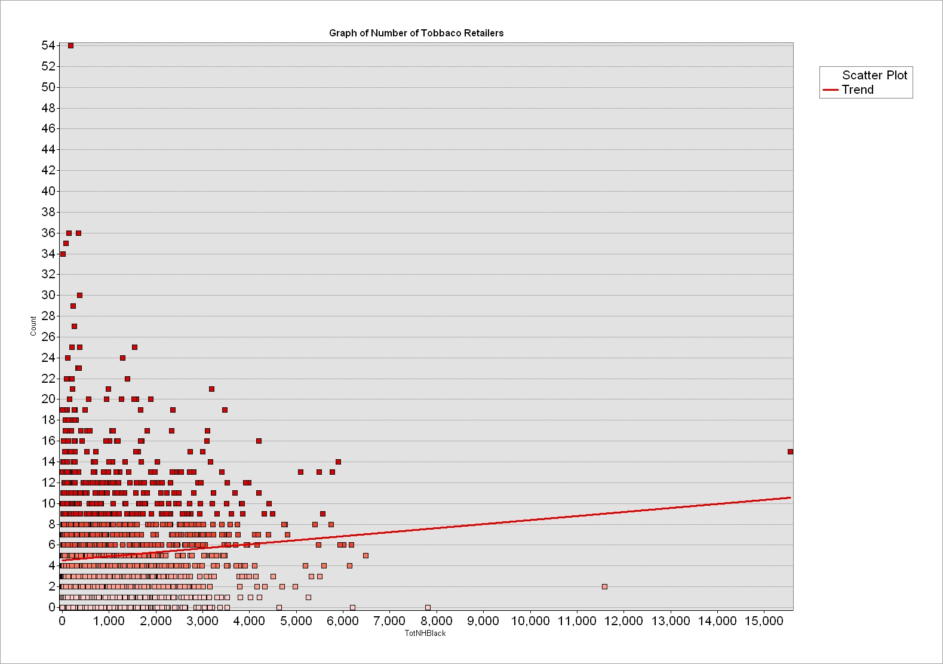
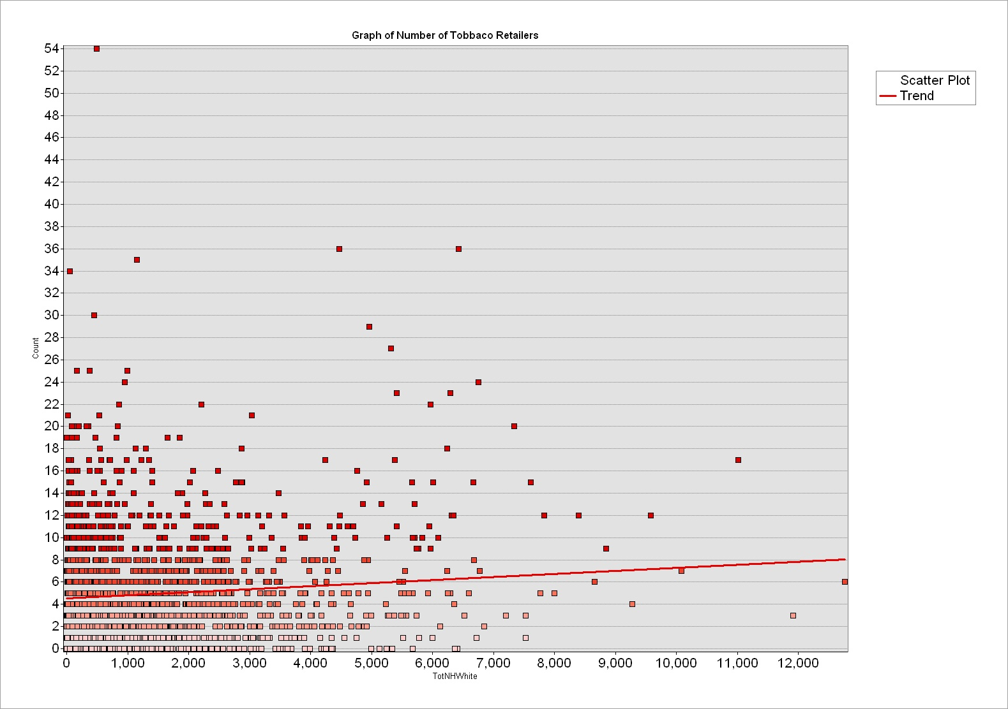
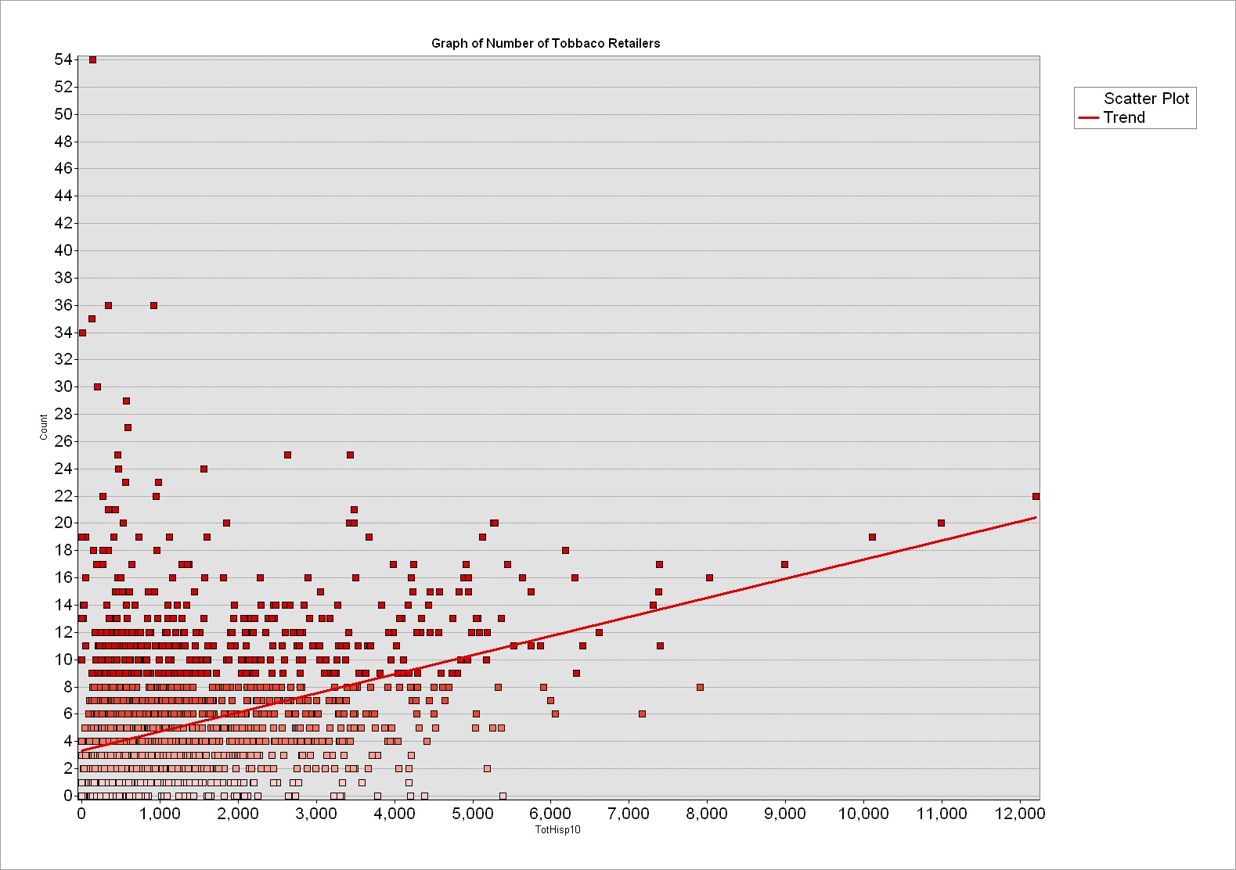
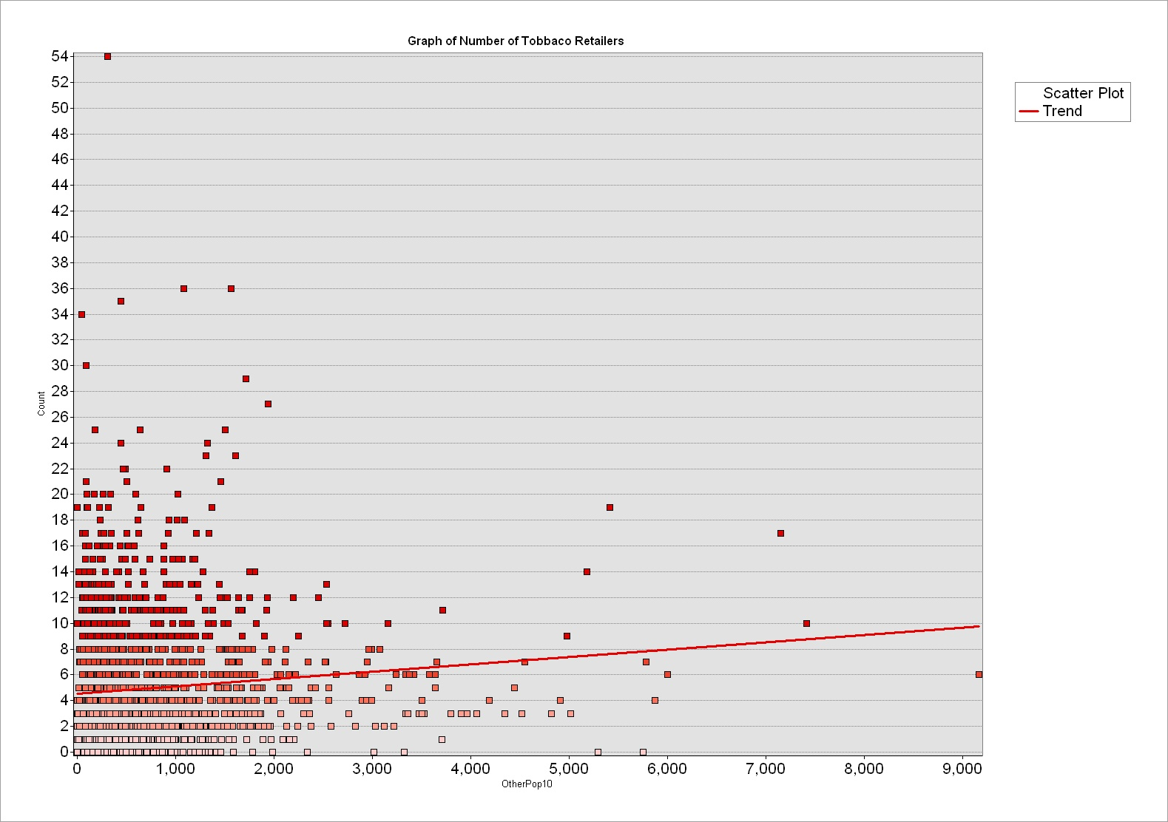
NH African American
NH White
Number of Tobacco Retailers VS Different Ethnics
Others
Hispanic

Slide 16
Analysis on NYC Tobacco & Liquor retailer Stores
Data Source
Methodology
Analysis
Conclusion
Introduction

Slide 17
Our Initial Guess:
Those stores normally appear themselves in those busy, populated and commercial areas.
Liquor Stores and Tobacco stores have the similar distribution patterns.
Our New Findings
Highest density of tobacco stores is located in the relatively lower income areas.
Liquor stores find their home at mid-level income areas, mainly in Manhattan area, especially below central park area.
Liquor stores and tobacco stores have different distributions surprisingly.
Future work:
Study more demographic features, or other urban datasets (noise, crime) related with the tobacco and liquor stores locations.
Spatial auto-correlation to study the relationship between neighborhoods.

